Slide 1
The Transport Layer
TCP
Chapter 6

Slide 2
TCP: Introduction (1)
Introduction to TCP
The TCP service model
The TCP protocol
The TCP segment header
TCP connection establishment
TCP connection release

Slide 3
TCP: Introduction (2)
TCP connection management modeling
TCP sliding window
TCP timer management
TCP congestion control
The future of TCP

Slide 4
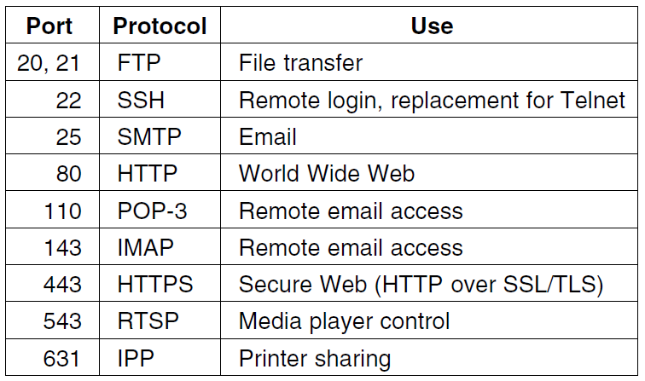
The TCP Service Model (1)
Fig.: Some assigned ports
Internet Daemon (inetd) attaches itself to multiple ports and waits for the first connection request, then forks to that service.

Slide 5
The TCP Service Model (2)
All TCP connections are full duplex and point-to-point.
Each connection has exactly two ends.
TCP doesn’t support multicasting or broadcasting.

Slide 6
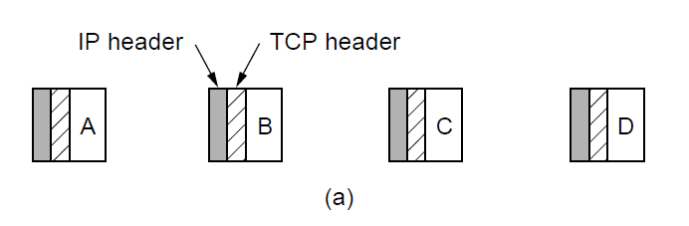
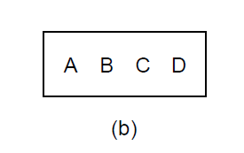
The TCP Service Model (3)
The TCP is byte-stream and not a message-stream, so messages are not differentiated.
Four 512-byte segments sent as separate IP diagrams.
The 2048 bytes of data delivered to the application in a single READ call.

Slide 7
The TCP Service Model (4)
To force data out – PUSH flag.
Too many PUSH-es; then all PUSH-es are collected together and sent.
URGENT flag – on pushing Ctrl-C to break-off remote computation, the sending application puts some control flag.

Slide 8
urgent data. for example, if an interactive user hits the CTRL-C key to break off a remote computation that has already begun, the sending application can put some control information in the data stream and give it to TCP along with the URGENT flag. This event causes TCP to stop accumulating data and transmit everything it has for that connection immediately.
When the urgent data are received at the destination, the receiving application is interrupted (e.g., given a signal in UNIX terms) so it can stop whatever it was doing and read the data stream to find the urgent data.
However, while urgent data is potentially useful, it found no compelling application early on and fell into disuse. Its use is now discouraged because of implementation differences, leaving applications to handle their own signaling. Perhaps future transport protocols will provide better signaling.

Slide 9
The TCP Protocol: Overview
Every byte on a TCP connection has its own 32-bit sequence number.
Separate 32-bit sequence numbers are carried on packets for the sliding window position in one direction and for ACKs in reverse.
The sending and receiving TCP entities exchange data in the form of segments.
TCP segment – 20 byte IP header, 20 byte TCP header, total 65,535 = 64 KB.
Two limits restrict the segment size:
  Each segment, including the TCP header, must fit in the 65,515-byte IP payload.
  Each link has an MTU (Maximum Transfer Unit).

Slide 10
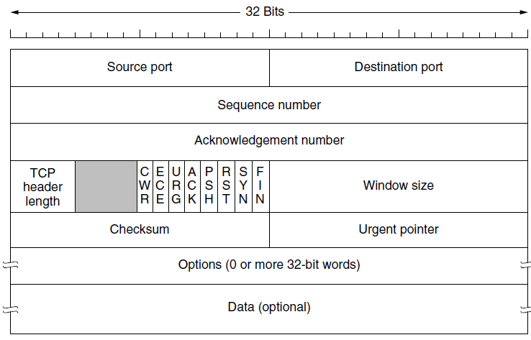
The TCP Segment Header (1)
ACK number = next expected byte
TCP header length – how many 32-bit words
One-bit flags:
CWR/ECE – Congestion signaling bits (ECE – signal ECN-Echo, CWR – Congestion window reduced)
URG – Urgent; Urgent pointer – byte offset where urgent data is present
ACK – Acknowledgement; PSH – Pushed; RST – reset – some problem has occured.
SYN = 1 (Connection request, connection accepted);
ACK =0 (Request), ACK = 1 (Accept)
Window size = how many buffers may be granted, can be zero.

Slide 11
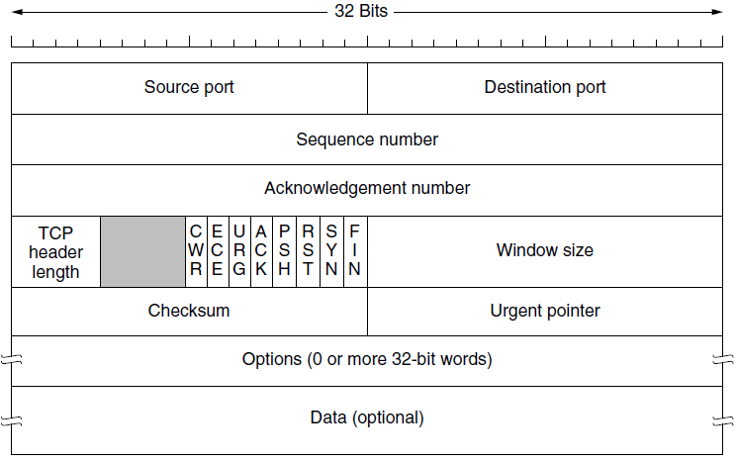
The TCP Segment Header (2)
Checksum – (IP Addr. + TCP pseudo-header + data)
Add all the 16 bits word in 1’s complement and then take 1’s complement of the sum.
Options field – Extra facilities not covered by the regular header
Example: MSS (Maximum segment size) host wants to accept

Slide 12
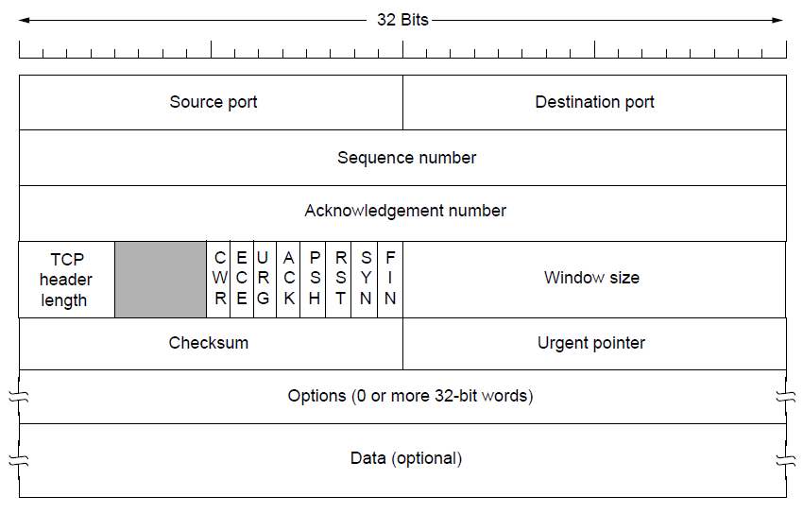
The TCP Segment Header (3)
Options:
Window scale: Sender and receiver negotiate a window scale factor
Timestamp: Included in every packet – useful in estimating RTT
PAWS (Protection against Wrapped Sequence numbers) uses timestamp to discard solve wrap-around problem
SACK (Selective ACK): Ranges of seq. nos. received by receiver

Slide 13
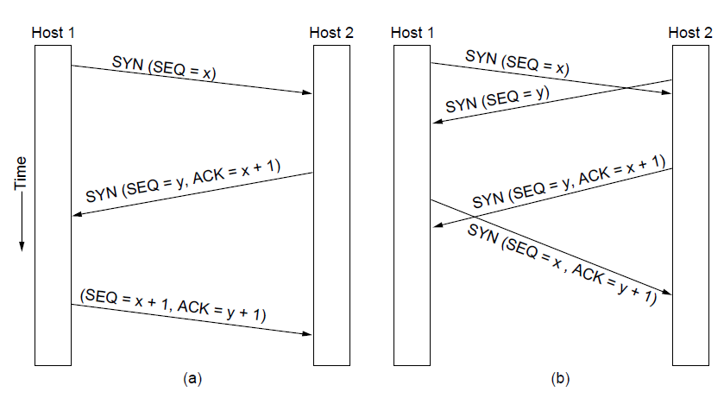
TCP Connection Establishment
TCP connection establishment in the normal case.
Simultaneous connection establishment on both sides
SYN flooding attack

Slide 14
TCP Connection Release
Either party sends with the FIN bit set.
When the FIN is acknowledged, that direction is shut down for new data.
Full closing (TWO FIN and TWO ACK).
If a response to a FIN is not forthcoming within two maximum packet lifetimes, the sender of the FIN releases the connection.

Slide 15
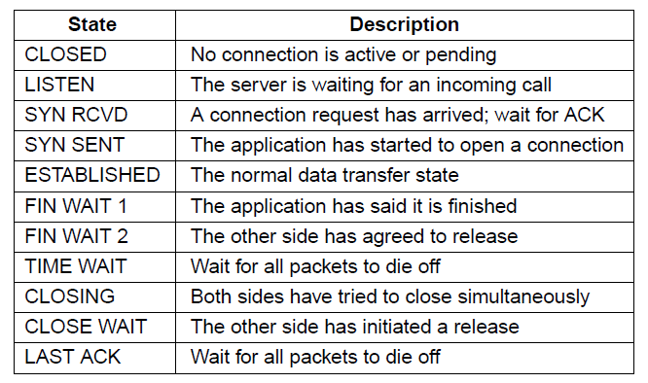
TCP Connection Management Modeling (1)
The states used in the TCP connection
management finite state machine.

Slide 16
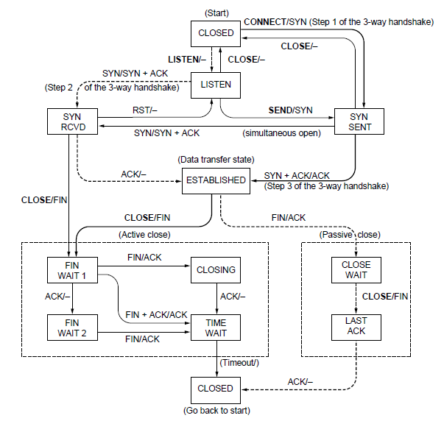
TCP Connection Management Modeling (2)
TCP connection management finite state machine.
The heavy solid line is the normal path for a client. The heavy dashed line is the normal path for a server. The light lines are unusual events. Each transition is labeled by the event causing it and the action resulting from it, separated by a slash.

Slide 17
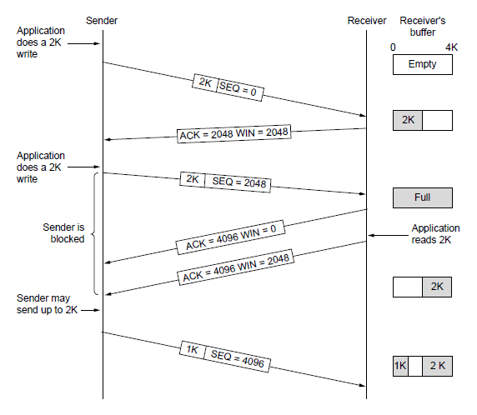
TCP Sliding Window (1)
Fig: Window management in TCP
When window is 0, sender doesn’t send segments except:
Urgent data (kill a remote process)
Window probe: 1- byte segment to make receiver re-announce next expected byte

Slide 18
Nagle’s Algorithm
Interactive Editor – Sending 1-byte would involve 162 bytes (41 to send, 40 to ACK, 40 to ACK, 41 to update)
Delayed acknowledgements. The idea is to delay acknowledgements and window updates for up to 500 msec in the hope of acquiring some data on which to hitch a free ride.
Nagle’s Algorithm – When data comes into the sender one byte at a time, just send the first byte and buffer the rest until the outstanding byte is acknowledged.
Once acknowledged, send all of the buffered data in one segment.
(deadlock with delayed acknowledgement)

Slide 19
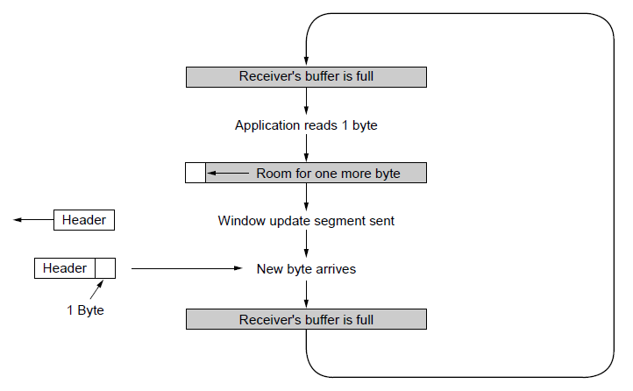
TCP Sliding Window (2)
Fig.: Silly window syndrome
Clark’s solution – prevent receiver from sending a window update for 1 byte.
Specifically, the receiver should not send a window update until it gets the maximum segment advertised free.

Slide 20
TCP Sliding Window (3)
Receiver’s side:
Receiver – Block READ from the application until a large chunk of data arrives.
Reduces number of calls to TCP, increases response time (but efficiency is more important to non-interactive applications than response time).
Issue of out-of-order packets:
Packets buffered and sent to the application in order.
Cumulative Acknowledgement
If 0, 1, 4, 5, 6, 7 received, then acknowledge up to 2.
Sender retransmits 3. On receipt of 3, acknowledge up to 7.

Slide 21
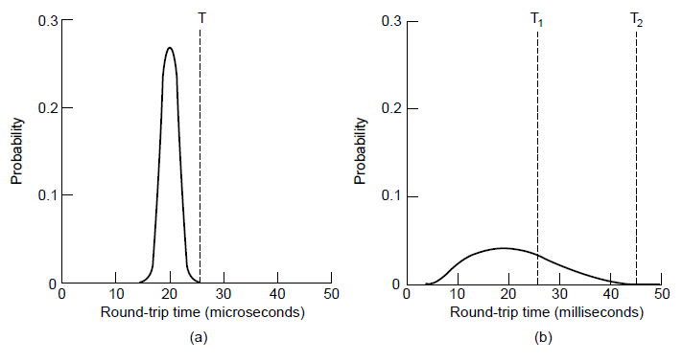
TCP Timer Management
(a) RTO (Retransmission TimeOut)
  Probability density of acknowledgment arrival times in data link layer.
  … for TCP

Slide 22
Retransmission Timer (1)
TCP maintains a variable, SRTT (Smoothed Round-Trip Time)
TCP measures how long an acknowledgement took (say, R), and updates SRTT as:
SRTT = α SRTT + (1 – α) R
Where α is the smoothing factor; typically α = 7/8.
RTTVAR (Round-Trip Time VARiation) is updated using:
RTTVAR = β RTTVAR + (1 – β) | SRTT – R |
Typically, β = 3/4.
Retransmission TimeOut (RTO) is set to:
RTO = SRTT + 4 x RTTVAR

Slide 23
Retransmission Timer (2)
Karn’s algorithm – In dynamic estimation of RTT, when a segment times out and is resent.
It is not clear whether the acknowledgement is from the original or resend.
So don’t include resent packet’s RTT into calculation.
Each time there is failure, double the Time-out value.

Slide 24
Persistence Timer
When Persistence timer goes off, the transmitter pings the receiver to know whether buffer space is available.
Keep-alive Timer
If idle → checks whether the connection is active and then if not closes connection
CONTROVERSIAL – It may stop healthy connection due to transient network partitioning

Slide 25
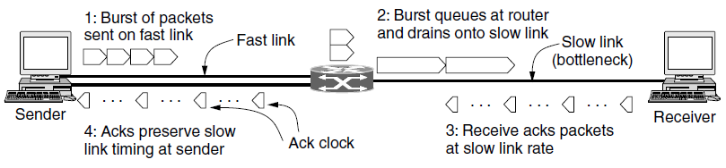
TCP Congestion Control (1)
Fig: A burst of packets from a sender and the returning ack clock.
Two windows:
(1) Flow control window: number of bytes the receiver can buffer
(2) Congestion window: number of bytes the sender may have in the network at any time

Slide 26
A second consideration is that the AIMD rule will take a very long time to reach a good operating point on fast networks if the congestion window is started from a small size.
Consider a modest network path that can support 10 Mbps with an RTT of 100 msec. The appropriate congestion window is the bandwidth-delay product, which is 1 Mbit or 100 packets of 1250 bytes each.
If the congestion window starts at 1 packet and increases by 1 packet every RTT, it will be 100 RTTs or 10 seconds before the connection is running at about the right rate.

Slide 27
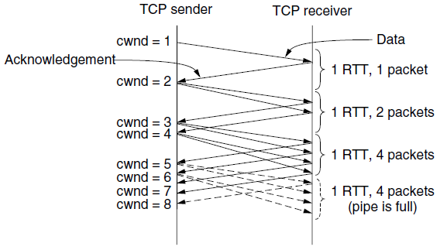
TCP Congestion Control (2)
Fig: Slow start from an initial congestion window of one segment.
Slow start
Start with small window, grow exponentially
Grow until a timeout occurs or the congestion window exceeds slow start threshold

Slide 28
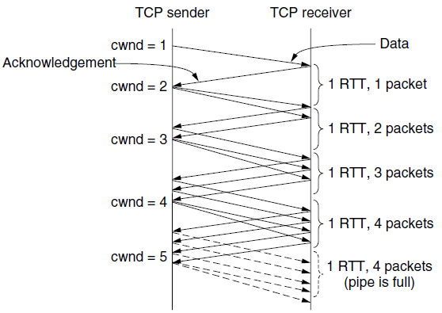
TCP Congestion Control (3)
Fig: Additive increase from an initial congestion window of one segment.
When slow start threshold is crossed, TCP switches from slow start to additive increase.
Congestion window is increased by 1 segment every RTT.

Slide 29
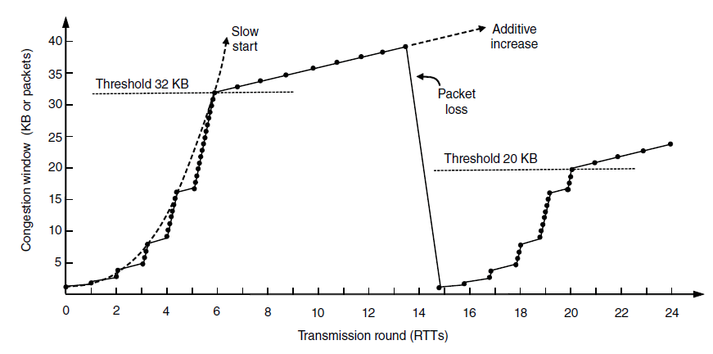
TCP Congestion Control (4)
Slow start followed by additive increase in TCP Tahoe.

Slide 30
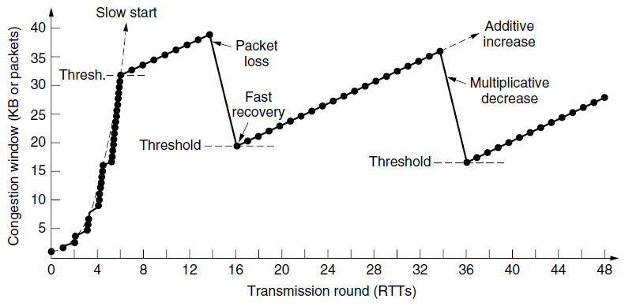
TCP Congestion Control (5)
Fast recovery and the sawtooth pattern of TCP Reno.

Slide 31
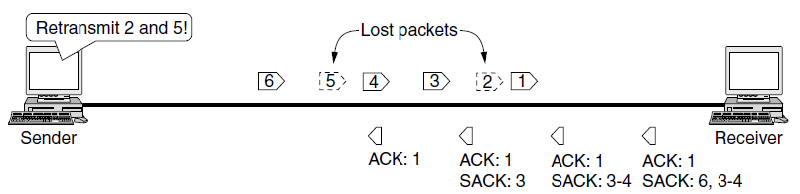
TCP Congestion Control (6)
Selective acknowledgements

Slide 32
Future of TCP
TCP does not provide the transport semantics that all applications want - TCP with its standard sockets interface does not meet needs well.
Congestion control is difficult with packet loss as an indicator in fast networks.

Slide 33
Continued …
Chapter 6

